Slide 1


Lesson 22
Dreamworld
UNIT 5

Slide 2

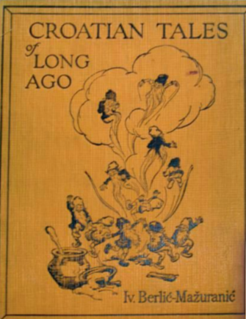
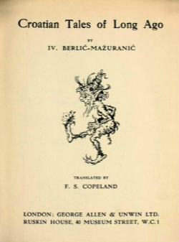
Do you like reading?
Can you name some of the main book genres?
Do you read fantasy novels?
Have you ever encountered any fantasy creatures in those books? Which?
Some of the most important book genres are: fantasy, Sci-Fi, mystery, thriller, romance, westerns, dystopian, and contemporary.
Here is a short list of fantasy creatures: brownies, elves, goblins, werewolves, witches, wizards, giants, ghosts, genies, fairies…
Make a table and write which of the creatures above are good and which are evil. Add reasons why.

Slide 3
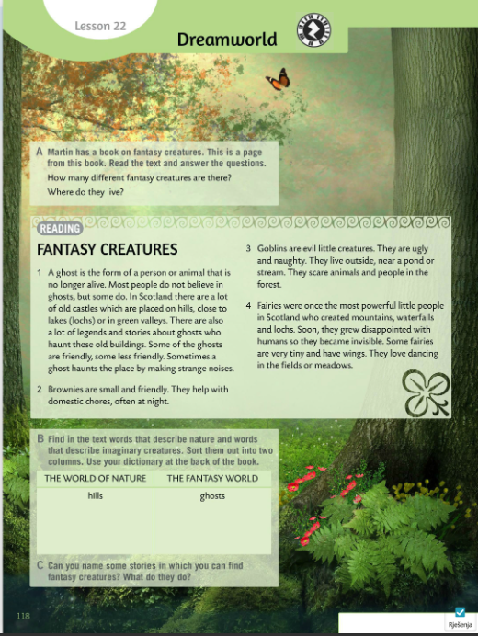
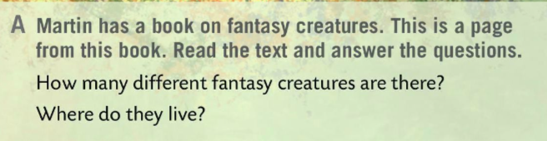
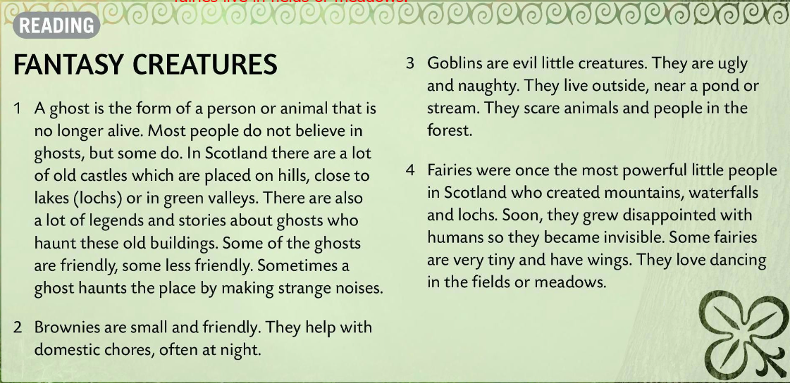
Martin has a book on fantasy creatures. This is a page from this book. Read the text and asnwer the questions.
Check.
1 There are four fantasy creatures: ghosts, brownies, goblins, and fairies.
2 Ghosts live in old castles, brownies live on farms, goblins live outside, and fairies live in fields or meadows.

Slide 4
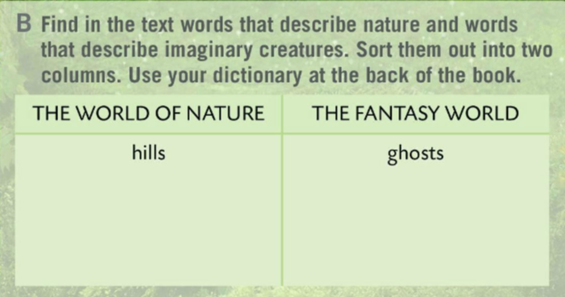
Read the text once again.
Fill in the table in Task B.
Find the words that describe nature and imaginary creatures.
Sort them out into two columns.
Use your dictionary at the back of the book.
lakes or lochs (jezera), valleys (doline), pond (bara), stream (potok), waterfalls (slapovi), mountains (planine), field (polje) , meadow (livada)
brownies, goblins, fairies
Check.
Can you name some stories in which you can find fantasy creatures?
What do they do?

Slide 5
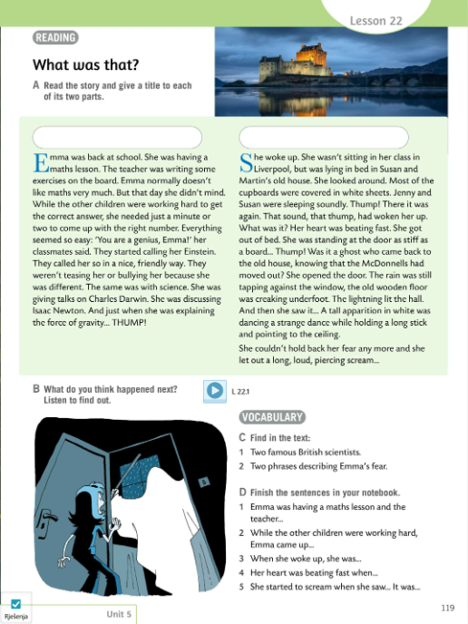
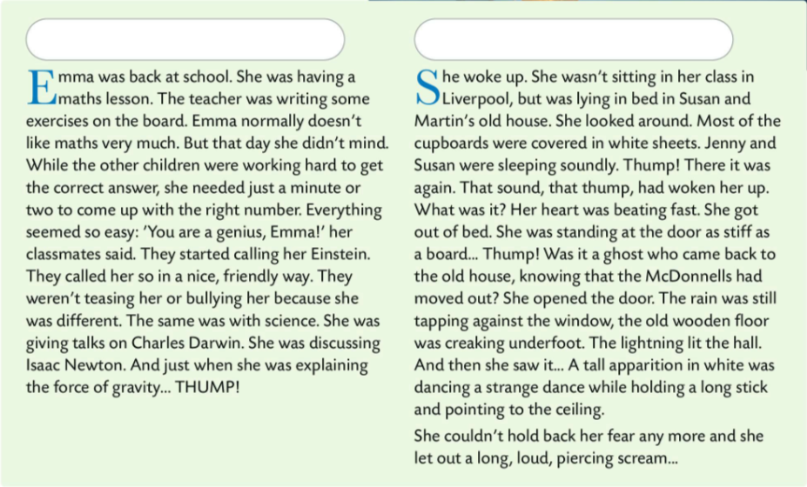
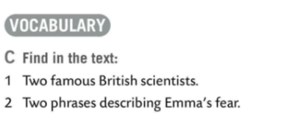

Read the story and give a title to each of its two parts.
Vote for the best two titles.
What do you think happened next? Discuss ideas in class.
Listen to the recording to find out.
Charles Darwin, Issac Newton
1 Her heart was beating fast.
2 She let out a long, loud, piercing scream.
Read the text once again.
Write answers to the questions in Task C.
Check.

Slide 6
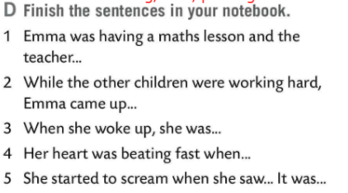
Finish the sentences in Task D.
Write the answers.
Check.
1 …was writing some exercises on the board.
2 …with the right number in a minute or two.
3 …was lying in bed in Susan and Martin’s old
house.
4 …she got out of bed.
5 …a tall apparition in white which was dancing a
strange dance while holding a long stick and
pointing to the ceiling. It was a ghost.

Slide 7
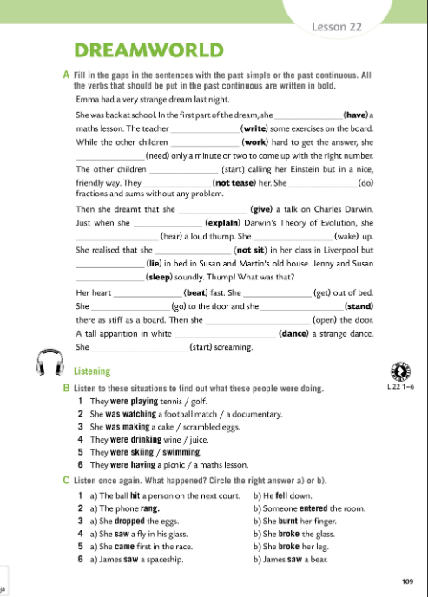

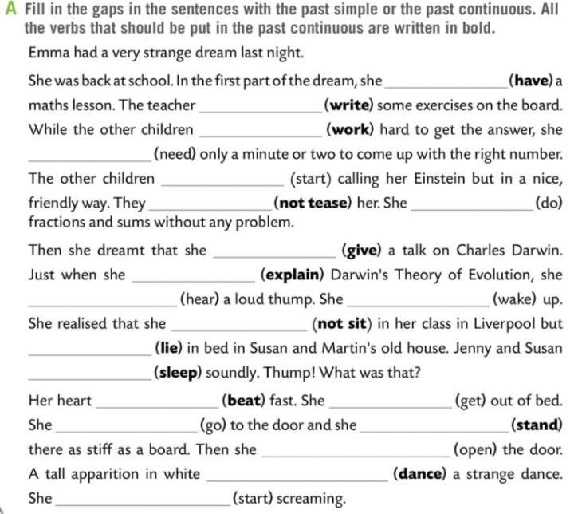
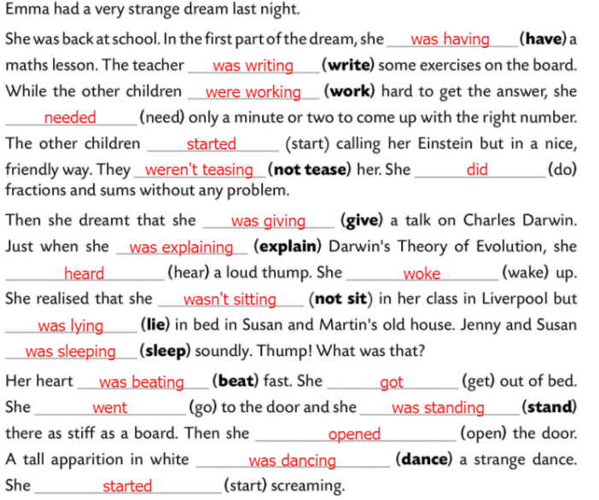
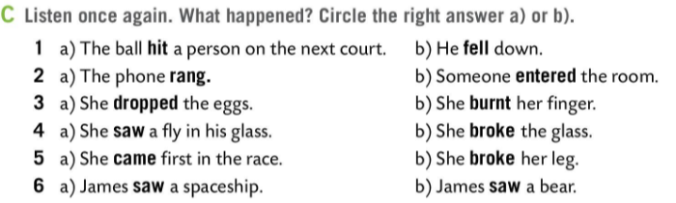
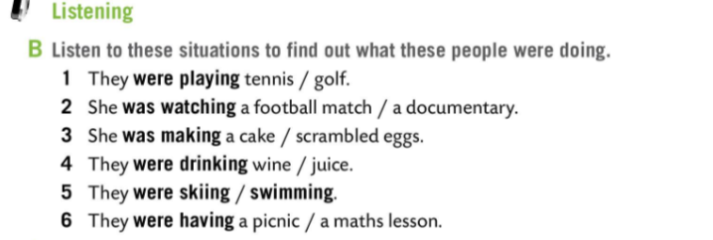
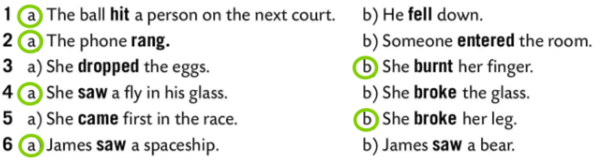
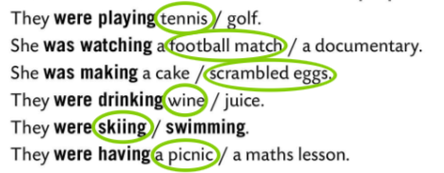
Workbook page 109.
Fill in the gaps in Task A with the past simple or past continuous. 2
All the verbs that should be put in the past continuous are written in bold.
Check.
Listen to the situations in Task B to find out what those people were doing.
Check.
Listen to the situations once again and circle the correct answer in Task C.
Check.

Slide 8
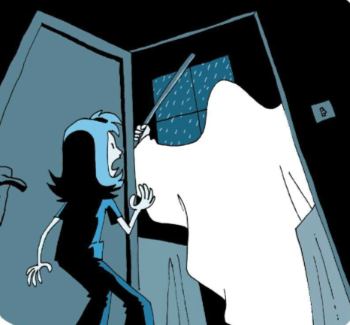
Play a game and revise!
https://wordwall.net/play/511/230/901

